Slide 1

Design and Analysis of Algorithms
Dina El-Manakhly, Ph. D.
dina_almnakhly@science.suez.edu.eg
Lecture 9

Slide 2
Dynamic programming (introduction)
The Fibonacci numbers F(n) are defined as follows:
Fibonacci numbers are: 0,1,1, 2, 3, 5, 8, 13,….
Each number in the sequence is the sum of the two preceding numbers.
Design and Analysis of Algorithms

Slide 3
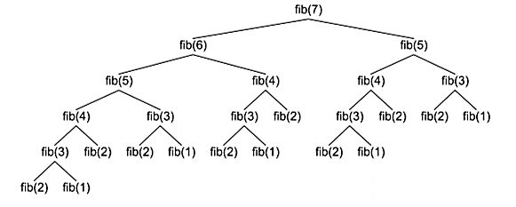
Dynamic programming (introduction)
Algorithm Fib(n)
Begin
if (n=0) then return 0
else if (n=1) then return 1
else return Fib(n-1)+ Fib(n-2)
End.
Recursively
The running time required to compute f(n) is exponential in the value of n (O(2^{n})).
Design and Analysis of Algorithms

Slide 4
Observations
Overlapping sub problems: where the solutions of the same sub-problems are required again and again.
Optimal substructure: an optimal solution to the problem can be constructed from optimal solutions of its sub problems.
Design and Analysis of Algorithms

Slide 5
Computing the n^{th} Fibonacci number using bottom-up iteration and recording results:
F(0) = 0
F(1) = 1
F(2) = 1+0 = 1
F(3) = 1+1=2
…
F(n-2) =
F(n-1) =
F(n) = F(n-1) + F(n-2)
Efficiency:
Time: O(n)
0 | 1 | 1 | …….. | F(n-2) | F(n-1) | F(n)
What if we solve it recursively?
Design and Analysis of Algorithms

Slide 6
Dynamic programming
Dynamic Programming is a technique in computer programming that helps to efficiently solve a class of problems that have overlapping sub problems and optimal substructure property.
DP is used to solve problems with the following characteristics:
(1) Optimal sub-structure: an optimal solution to the problem can be constructed from optimal solutions of its sub problems.
(2) Overlapping sub problems: there exist some places where we solve the same sub problem more than once.
Dynamic Programming is an algorithm design technique for optimization problems: often minimizing or maximizing.
Design and Analysis of Algorithms

Slide 7
Dynamic programming
Dynamic programming works by storing the result of sub-problems so that when their solutions are required, they are at hand and we do not need to recalculate them.
This technique of storing the value of sub-problems is called memoization or tabulation. By saving the values in the array, we save time for computations of sub-problems we have already come across.
Design and Analysis of Algorithms

Slide 8
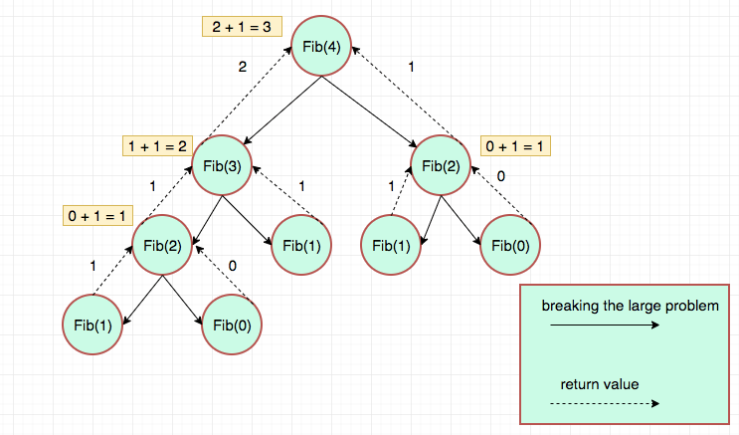
Divide and Conquer (D&C) & Dynamic programming (DP) methods:
Similarity
Both: split a problem into separate sub-problems of small size.
Both: solve problems by combining solutions to sub-problems.
Dissimilarity
DP sub-problems are dependent (overlaps), while D&C sub-problems are independent.
D&C top down, while DP bottom up techniques.
Top-Down
Design and Analysis of Algorithms

Slide 9
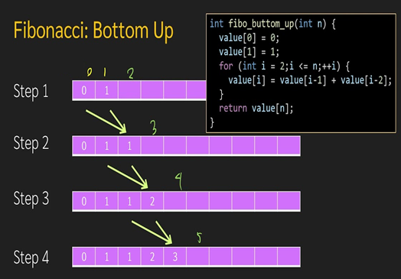
Divide and Conquer (D&C) & Dynamic programming (DP) methods:
Similarity
Both: split a problem into separate sub-problems of small size.
Both: solve problems by combining solutions to sub-problems.
Dissimilarity
DP sub-problems are dependent (overlaps), while D&C sub-problems are independent.
D&C top down, while DP bottom up techniques.
Bottom-Up
Design and Analysis of Algorithms

Slide 10
Greedy method (G) & Dynamic programming (DP) method:
Similarity
Both techniques solve optimization problems.
Both techniques exhibit optimal substructure.
Dissimilarity
DP explores various sequences of sub problems to find the best overall solution, while the G technique follows a single decision sequence, making locally optimal choices at each step.
G method is easier than DP. DP is more expensive (Time and space requirements are high, since storage is needed for all level). Therefore, we first try greedy algorithm. If it fails then try DP.
Design and Analysis of Algorithms

Slide 11
Different Types of Dynamic Programming Algorithms
Longest Common Subsequence
Floyd-Warshall Algorithm
Design and Analysis of Algorithms

Slide 12
Longest Common Subsequence
The longest common subsequence (LCS) is defined as the longest subsequence that is common to all the given sequences, provided that the elements of the subsequence are not required to occupy consecutive positions within the original sequences.
If S1 and S2 are the two given sequences then, Z is the common subsequence of S1 and S2 if Z is a subsequence of both S1 and S2. Furthermore, Z must be a strictly increasing sequence of the indices of both S1 and S2.
In a strictly increasing sequence, the indices of the elements chosen from the original sequences must be in ascending order in Z.
If
S1 = {B, C, D, A, A, C, D}
Then, {A, D, B} cannot be a subsequence of S1 as the order of the elements is not the same (i.e.. not strictly increasing sequence).
Design and Analysis of Algorithms

Slide 13
Example
If
S1 = {B, C, D, A, A, C, D}
S2 = {A, C, D, B, A, C}
Then, common subsequences are
{B, C},
{C, D, A, C},
{D, A, C},
{A, A, C},
{A, C},
{C, D},
Among these subsequences, {C, D, A, C} is the longest common subsequence.
Design and Analysis of Algorithms

Slide 14
Using Dynamic Programming to find the LCS
The following steps are followed for finding the longest common subsequence:
1. Create a table of dimension n+1*m+1 where n and m are the lengths of A and B respectively.
The first row and the first column are filled with zeros.
2. If the character corresponding to the current row and current column are matching, then fill the current cell by adding one to the diagonal element. Point an arrow to the diagonal cell. Let L[i,j] denote the length of a longest common subsequence.
If a_{i}=b_{j} then L[i,j]=L[i-1,j-1]+1
3. Else take the maximum value from the previous column and previous row element for filling the current cell. Point an arrow to the cell with maximum value. If they are equal, point to any of them.
If a_{i} ≠ b_{j} then L[i,j]= Max{L[i,j-1],L[i-1,j]}
Design and Analysis of Algorithms

Slide 15
Given two strings A=lion and B=line. Find LCS.
B
Example 1
Find the length of the longest common subsequence
 | ɛ | l | i | n | e
ɛ
l
I
o
n
A
 | ɛ | l | i | n | e
ɛ
l
I
o
n
0
0
0
0
0
0
0
0
0
Design and Analysis of Algorithms

Slide 16
Step 2 and 3
If a_{i}=b_{j} then L[i,j]=L[i-1,j-1]+1.
L[i-1,j-1]
L[i-1,j]
+1
L[i,j-1]
L[i,j]
If a_{i} ≠ b_{j} then L[i,j]= Max{L[i,j-1],L[i-1,j]}
Step 3 and 3
L[i-1,j-i]
L[i-1,j]
maximum
L[i,j-1]
L[i,j]
Design and Analysis of Algorithms

Slide 17
Given two strings A=lion and B=line. Find LCS.
B
Example 1
Find the length of the longest common subsequence
 | ɛ | l | i | n | e
ɛ
l
I
o
n
A
 | ɛ | l | i | n | e
ɛ
l
I
o
n
0
0
0
0
0
0
0
0
0
Design and Analysis of Algorithms

Slide 18
Given two strings A=lion and B=line. Find LCS.
 | ɛ | l | i | n | e
ɛ | 0 | 0 | 0 | 0 | 0
l | 0
i | 0
O | 0
n | 0
1
1
1
1
Design and Analysis of Algorithms

Slide 19
Given two strings A=lion and B=line. Find LCS.
 | ɛ | l | i | n | e
ɛ | 0 | 0 | 0 | 0 | 0
l | 0 | 1 | 1 | 1 | 1
i | 0
o | 0
n | 0
1
2
2
2
Design and Analysis of Algorithms

Slide 20
Given two strings A=lion and B=line. Find LCS.
 | ɛ | l | i | n | e
ɛ | 0 | 0 | 0 | 0 | 0
l | 0 | 1 | 1 | 1 | 1
i | 0 | 1 | 2 | 2 | 2
o | 0
n | 0
1
2
2
2
Design and Analysis of Algorithms

Slide 21
Given two strings A=lion and B=line. Find LCS.
 | ɛ | l | i | n | e
ɛ | 0 | 0 | 0 | 0 | 0
l | 0 | 1 | 1 | 1 | 1
i | 0 | 1 | 2 | 2 | 2
o | 0 | 1 | 2 | 2 | 2
n | 0
1
2
3
3
The bottom right corner is the length of the LCS=3
Design and Analysis of Algorithms

Slide 22
Given two strings A=alignment and B=algorithm. Find LCS.
Example 2
Find the length of the longest common subsequence
 |  | a | l | i | g | n | m | e | n | t
 | 0 | 0 | 0 | 0 | 0 | 0 | 0 | 0 | 0 | 0
a | 0 | 1 | 1 | 1 | 1 | 1 | 1 | 1 | 1 | 1
l | 0
g | 0
o | 0
r | 0
i | 0
t | 0
h | 0
m | 0
Design and Analysis of Algorithms

Slide 23
Given two strings A=alignment and B=algorithm. Find LCS.
 |  | a | l | i | g | n | m | e | n | t
 | 0 | 0 | 0 | 0 | 0 | 0 | 0 | 0 | 0 | 0
a | 0 | 1 | 1 | 1 | 1 | 1 | 1 | 1 | 1 | 1
l | 0 | 1 | 2 | 2 | 2 | 2 | 2 | 2 | 2 | 2
g | 0
o | 0
r | 0
i | 0
t | 0
h | 0
m | 0
Design and Analysis of Algorithms

Slide 24
Given two strings A=alignment and B=algorithm. Find LCS.
 |  | a | l | i | g | n | m | e | n | t
 | 0 | 0 | 0 | 0 | 0 | 0 | 0 | 0 | 0 | 0
a | 0 | 1 | 1 | 1 | 1 | 1 | 1 | 1 | 1 | 1
l | 0 | 1 | 2 | 2 | 2 | 2 | 2 | 2 | 2 | 2
g | 0 | 1 | 2 | 2 | 3 | 3 | 3 | 3 | 3 | 3
o | 0
r | 0
i | 0
t | 0
h | 0
m | 0
Design and Analysis of Algorithms

Slide 25
Given two strings A=alignment and B=algorithm. Find LCS.
 |  | a | l | i | g | n | m | e | n | t
 | 0 | 0 | 0 | 0 | 0 | 0 | 0 | 0 | 0 | 0
a | 0 | 1 | 1 | 1 | 1 | 1 | 1 | 1 | 1 | 1
l | 0 | 1 | 2 | 2 | 2 | 2 | 2 | 2 | 2 | 2
g | 0 | 1 | 2 | 2 | 3 | 3 | 3 | 3 | 3 | 3
o | 0 | 1 | 2 | 2 | 3 | 3 | 3 | 3 | 3 | 3
r | 0
i | 0
t | 0
h | 0
m | 0
Design and Analysis of Algorithms

Slide 26
Given two strings A=alignment and B=algorithm. Find LCS.
 |  | a | l | i | g | n | m | e | n | t
 | 0 | 0 | 0 | 0 | 0 | 0 | 0 | 0 | 0 | 0
a | 0 | 1 | 1 | 1 | 1 | 1 | 1 | 1 | 1 | 1
l | 0 | 1 | 2 | 2 | 2 | 2 | 2 | 2 | 2 | 2
g | 0 | 1 | 2 | 2 | 3 | 3 | 3 | 3 | 3 | 3
o | 0 | 1 | 2 | 2 | 3 | 3 | 3 | 3 | 3 | 3
r | 0 | 1 | 2 | 2 | 3 | 3 | 3 | 3 | 3 | 3
i | 0
t | 0
h | 0
m | 0
Design and Analysis of Algorithms
Design and Analysis of Algorithms

Slide 27
Given two strings A=alignment and B=algorithm. Find LCS.
 |  | a | l | i | g | n | m | e | n | t
 | 0 | 0 | 0 | 0 | 0 | 0 | 0 | 0 | 0 | 0
a | 0 | 1 | 1 | 1 | 1 | 1 | 1 | 1 | 1 | 1
l | 0 | 1 | 2 | 2 | 2 | 2 | 2 | 2 | 2 | 2
g | 0 | 1 | 2 | 2 | 3 | 3 | 3 | 3 | 3 | 3
o | 0 | 1 | 2 | 2 | 3 | 3 | 3 | 3 | 3 | 3
r | 0 | 1 | 2 | 2 | 3 | 3 | 3 | 3 | 3 | 3
i | 0 | 1 | 2 | 3 | 3 | 3 | 3 | 3 | 3 | 3
t | 0
h | 0
m | 0
Design and Analysis of Algorithms

Slide 28
Given two strings A=alignment and B=algorithm. Find LCS.
 |  | a | l | i | g | n | m | e | n | t
 | 0 | 0 | 0 | 0 | 0 | 0 | 0 | 0 | 0 | 0
a | 0 | 1 | 1 | 1 | 1 | 1 | 1 | 1 | 1 | 1
l | 0 | 1 | 2 | 2 | 2 | 2 | 2 | 2 | 2 | 2
g | 0 | 1 | 2 | 2 | 3 | 3 | 3 | 3 | 3 | 3
o | 0 | 1 | 2 | 2 | 3 | 3 | 3 | 3 | 3 | 3
r | 0 | 1 | 2 | 2 | 3 | 3 | 3 | 3 | 3 | 3
i | 0 | 1 | 2 | 3 | 3 | 3 | 3 | 3 | 3 | 3
t | 0 | 1 | 2 | 3 | 3 | 3 | 3 | 3 | 3 | 4
h | 0
m | 0
Design and Analysis of Algorithms

Slide 29
Given two strings A=alignment and B=algorithm. Find LCS.
 |  | a | l | i | g | n | m | e | n | t
 | 0 | 0 | 0 | 0 | 0 | 0 | 0 | 0 | 0 | 0
a | 0 | 1 | 1 | 1 | 1 | 1 | 1 | 1 | 1 | 1
l | 0 | 1 | 2 | 2 | 2 | 2 | 2 | 2 | 2 | 2
g | 0 | 1 | 2 | 2 | 3 | 3 | 3 | 3 | 3 | 3
o | 0 | 1 | 2 | 2 | 3 | 3 | 3 | 3 | 3 | 3
r | 0 | 1 | 2 | 2 | 3 | 3 | 3 | 3 | 3 | 3
i | 0 | 1 | 2 | 3 | 3 | 3 | 3 | 3 | 3 | 3
t | 0 | 1 | 2 | 3 | 3 | 3 | 3 | 3 | 3 | 4
h | 0 | 1 | 2 | 3 | 3 | 3 | 3 | 3 | 3 | 4
m | 0
Design and Analysis of Algorithms

Slide 30
Given two strings A=alignment and B=algorithm. Find LCS.
 |  | a | l | i | g | n | m | e | n | t
 | 0 | 0 | 0 | 0 | 0 | 0 | 0 | 0 | 0 | 0
a | 0 | 1 | 1 | 1 | 1 | 1 | 1 | 1 | 1 | 1
l | 0 | 1 | 2 | 2 | 2 | 2 | 2 | 2 | 2 | 2
g | 0 | 1 | 2 | 2 | 3 | 3 | 3 | 3 | 3 | 3
o | 0 | 1 | 2 | 2 | 3 | 3 | 3 | 3 | 3 | 3
r | 0 | 1 | 2 | 2 | 3 | 3 | 3 | 3 | 3 | 3
i | 0 | 1 | 2 | 3 | 3 | 3 | 3 | 3 | 3 | 3
t | 0 | 1 | 2 | 3 | 3 | 3 | 3 | 3 | 3 | 4
h | 0 | 1 | 2 | 3 | 3 | 3 | 3 | 3 | 3 | 4
m | 0 | 1 | 2 | 3 | 3 | 3 | 4 | 4 | 4 | 4
The bottom right corner is the length of the LCS=4
Design and Analysis of Algorithms

Slide 31
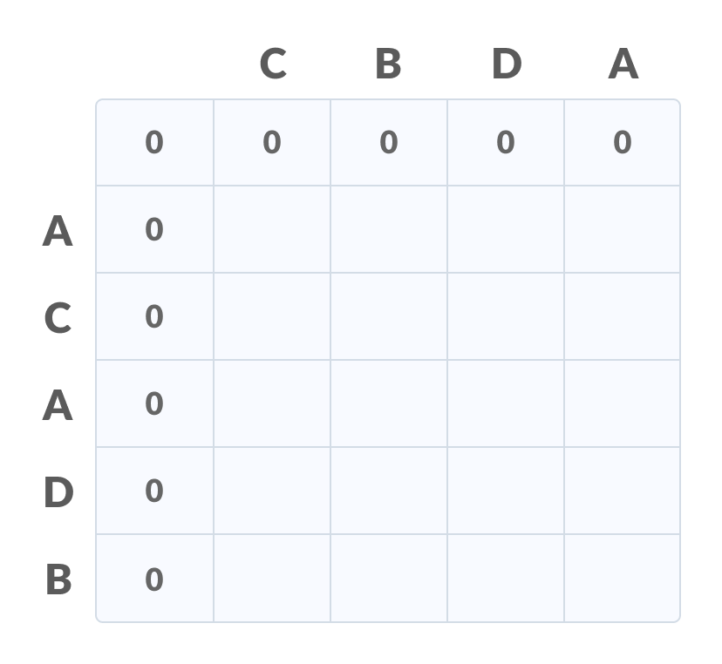
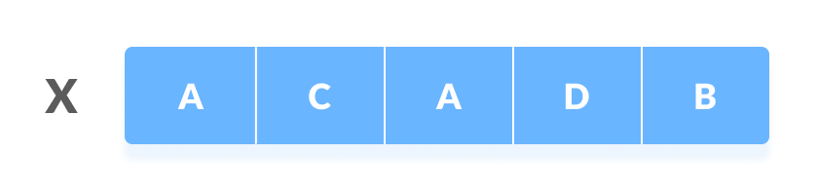
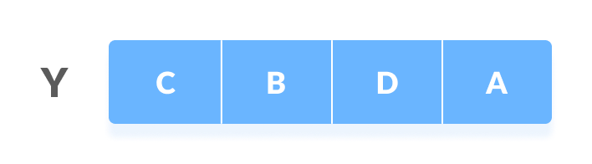
Example 3
Find the longest common subsequence and the length
The first sequence
The second sequence
Design and Analysis of Algorithms

Slide 32
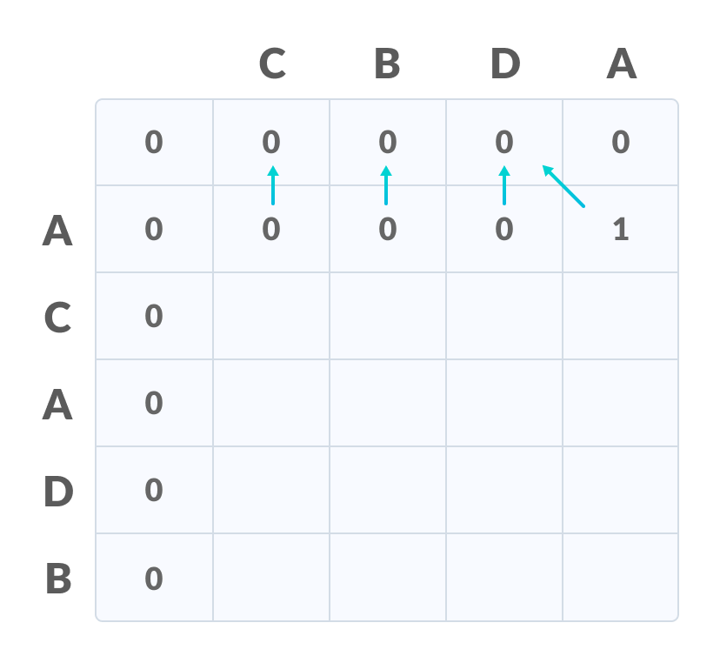
The first sequence
The second sequence
Design and Analysis of Algorithms

Slide 33
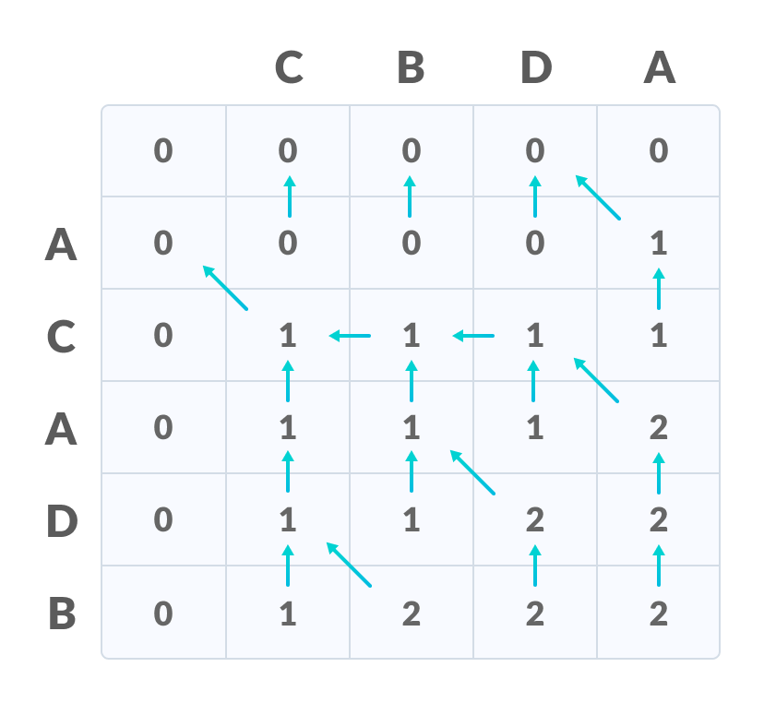
The first sequence
The second sequence
Design and Analysis of Algorithms

Slide 34
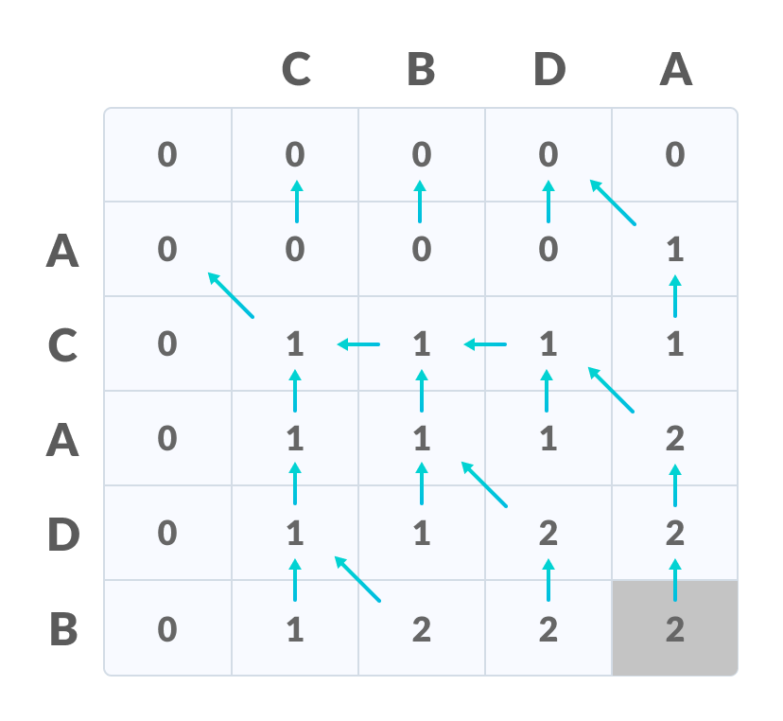
The first sequence
The second sequence
The bottom right corner is the length of the LCS=2
Design and Analysis of Algorithms

Slide 35
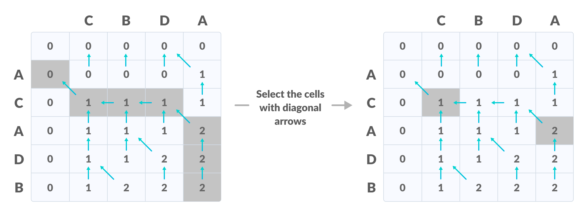
In order to find the longest common subsequence, start from the last element and follow the direction of the arrow.
Thus, the longest common subsequence is CA.
Design and Analysis of Algorithms

Slide 36
Algorithm
Algorithm LCS
Input: two strings A and B of lengths n and m respectively.
Output: The length of the longest common subsequences of A and B.
Begin
for i=0 to n do
L[i,0]=0
for j=0 to m do
L[0,j]=0
for i=1 to n do
for j=1 to m do
if ai = bj then L[i,j]=L[i-1,j-1]+1
else L[i,j]=max{ L[i,j-1],L[i-1,j] }
return L[i,j]
End.
Time efficiency: O(n m).
Design and Analysis of Algorithms

Slide 37
Home Work (Dynamic Programming)
Find the longest subsequence common between:
“human” and “chimpanzee”.
“tail” and “tall”.
“common” and “coin”.
Design and Analysis of Algorithms

